Slide 1


Dr Ross Mounce, Director of Open Access Programmes
@rmounce@mastodon.social

Slide 2

Talk Outline
What is Arcadia?
Examples of grants and organisations we’ve funded
Beyond APC/BPC models
Building a better scholarly world
-> the global alliance for diamond open access
A reminder of just how bad the legacy publishing system is
Notes:
So far Arcadia has awarded grants worth 1.2 billion US dollars since 2002. Open access is one of the smaller programmes at Arcadia but that’s okay – it’s still a lot money.

Slide 3
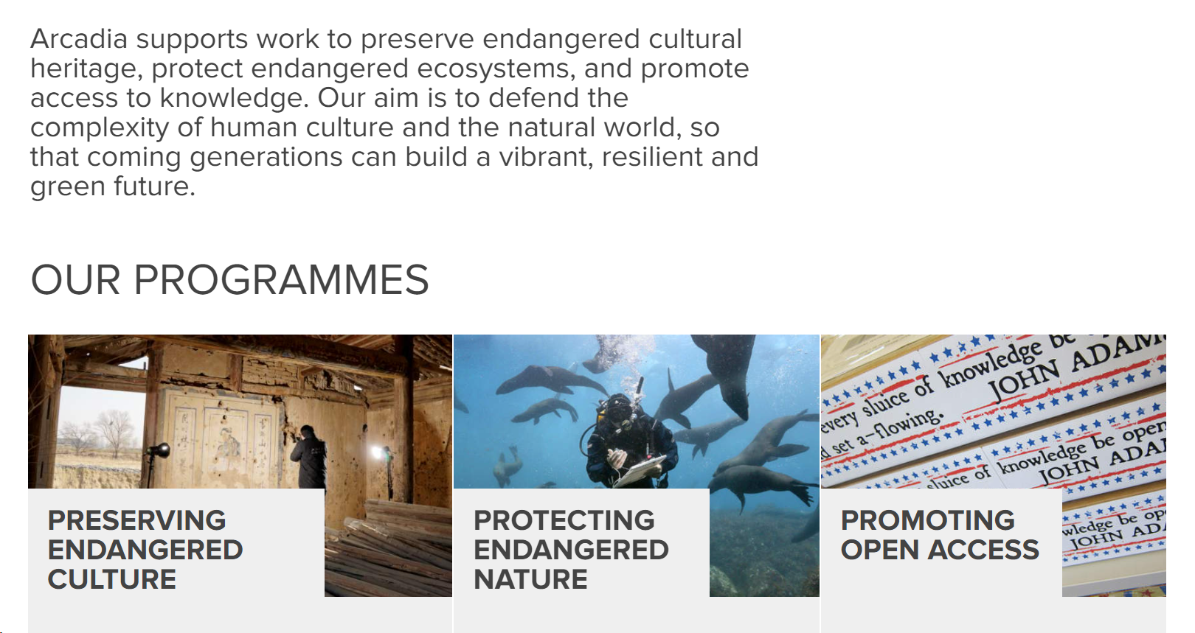
The 3 Programmes at Arcadia

Slide 4
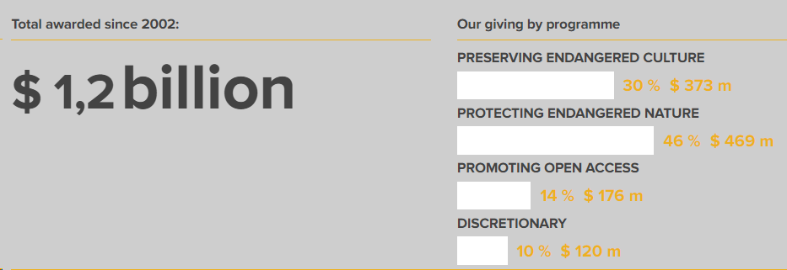
Grants Overview
Notes:
So far Arcadia has awarded grants worth 1.2 billion US dollars since 2002. Open access is one of the smaller programmes at Arcadia but that’s okay – it’s still a lot money.

Slide 5
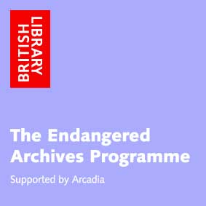
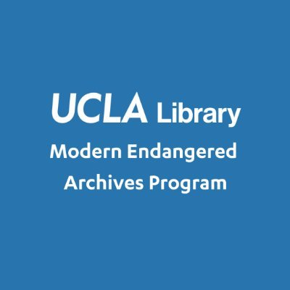





Examples of initiatives supported by Arcadia’s Culture Programme

Slide 6
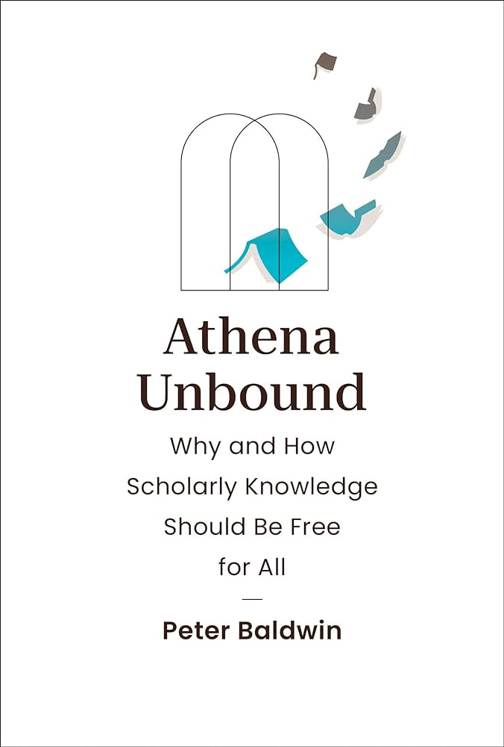

Windows of insight into Arcadia thinking
“The desire for prestige blinds even young scholars to how, by sticking with traditional outlets, they effectively extinguish their work.”
Peter Baldwin (2018)
Baldwin P (2018) Why Are Universities Open-Access Laggards? Bulletin of the GHI Washington, Issue 63 pp.67–80 https://perspectivia.net/receive/pnet_mods_00002460
10.7551/mitpress/14887.001.0001
Notes:
It’s a pleasure to work for the Arcadia donors – they are really knowledgeable about open access. If you want to know more about what Arcadia thinks about open access I’d recommend these two publications; on the left a journal article which I note is available on the Perspectivia platform [shout out to Max Weber Stiftung], and on the right a much more recent book that is published with MIT Press

Slide 7
Access to knowledge is a fundamental human right. It advances research and innovation, improves decision-making, exposes misinformation and is vital to achieving greater equality and justice. The internet has transformed how we share, find and use information. But some materials that should legally and morally be free for anyone to access are still constrained by paywalls and restrictive copyright regimes.
Our grants help make this important information – including publicly funded research, standards, and laws – available for free online, and help people find and use this information. We do this by supporting direct activism for open access, and by working to improve open access to scholarship and the discoverability of open access content.
from: https://www.arcadiafund.org.uk/promoting-open-access

Slide 8
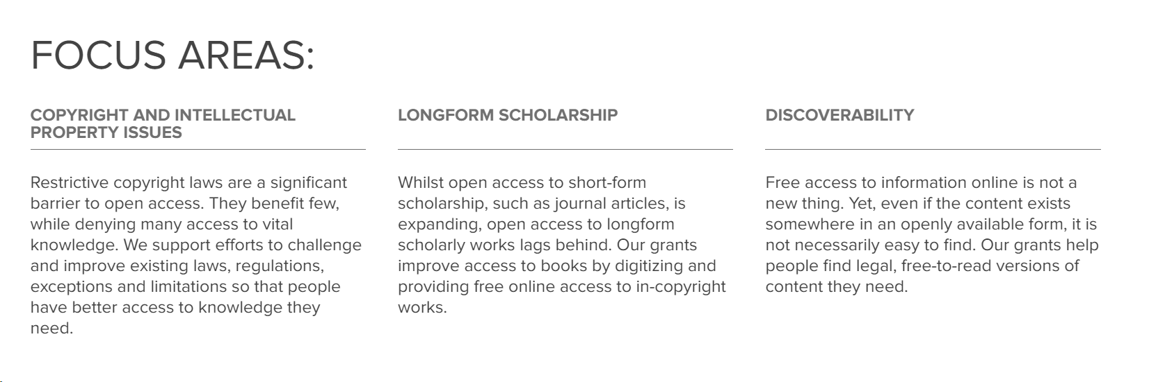









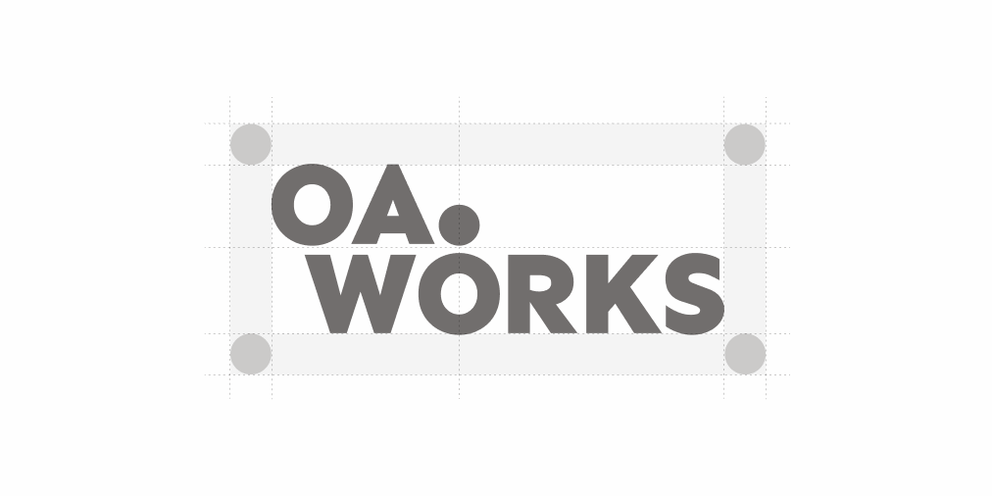


Slide 9
Tools for helping us think about ‘sustainability’ in the scholarly ecosystem

Slide 10

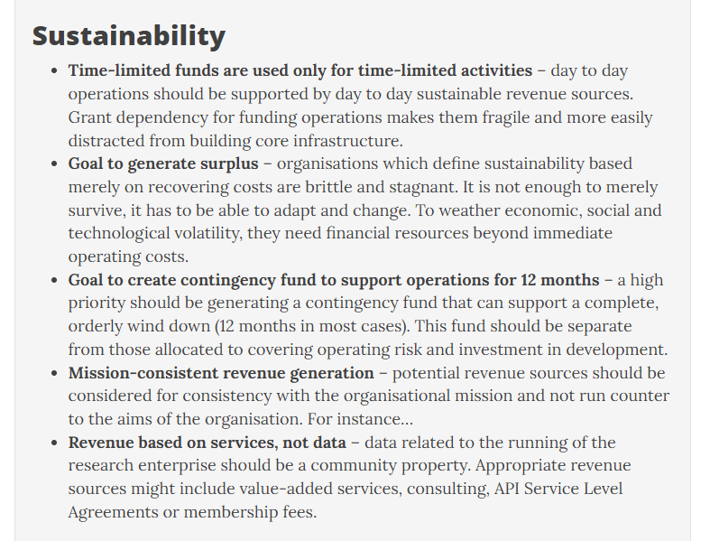
OpenScholarlyInfrastructure.org

Slide 11
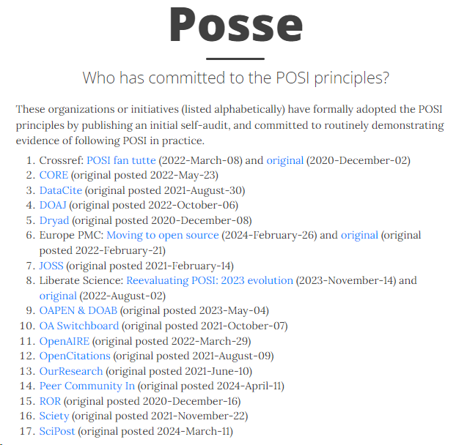
A call to join the POSI posse
The open community needs to articulate why it offers a better solution.
I think POSI is a smart endeavour in that regard.
OpenScholarlyInfrastructure.org

Slide 12
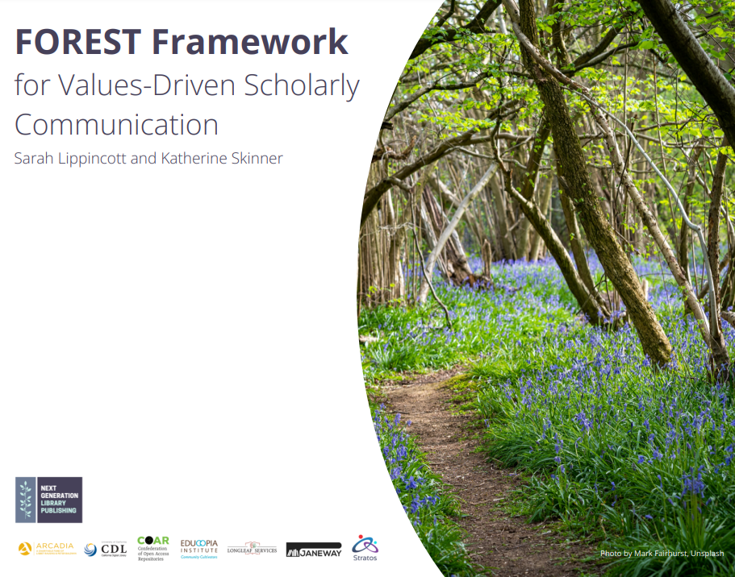
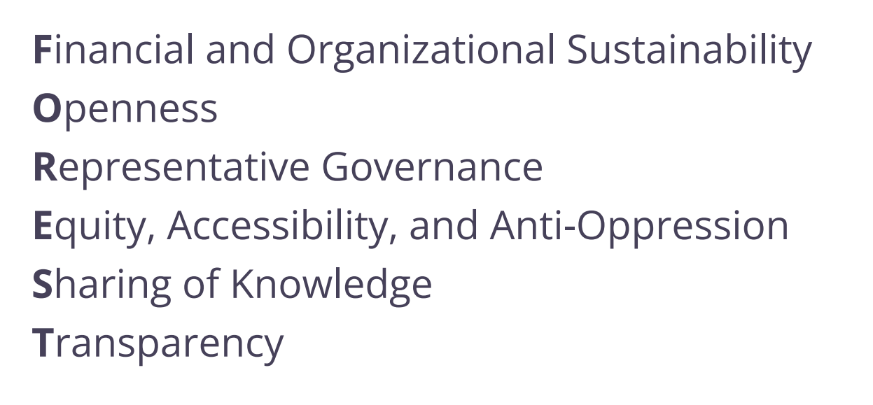

Slide 13

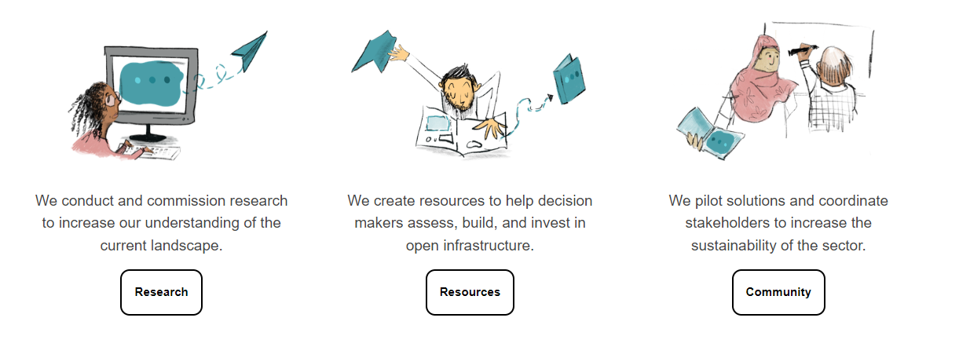





Supported by grants from these (and more):

Slide 14

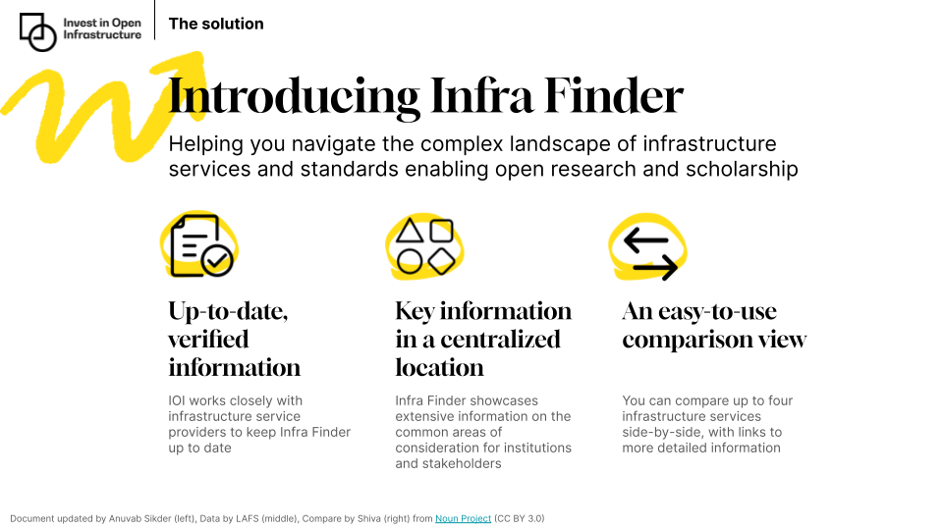
Documenting open infrastructure
infrafinder.investinopen.org

Slide 15
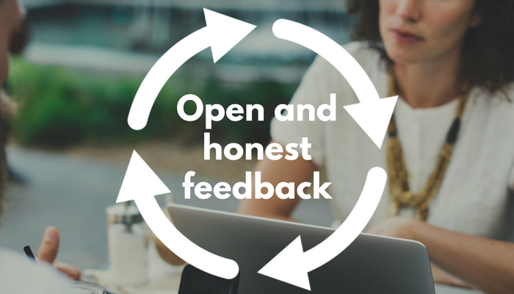
Additions and feedback are welcome!
Is your open infrastructure not yet in Infra Finder?
You can change that by filling out the expression of interest form*:
https://investinopen.org/add-an-infrastructure-to-infra-finder/
Infra Finder is not yet perfect
If you have feedback you’d like to give IOI, please do.
*The expression of interest form should only be submitted by those affiliated with the service itself

Slide 16


Coming soon…
+
The State of Open Infrastructure report:
surfacing trends, patterns, and gaps in the investment in and adoption of open infrastructure
The first edition will be published next month (May)…

Slide 17
Beyond APC/BPC models

Slide 18

Beyond APC’s , BPC’s , and ADC’s – MIT Press
Books
D2O statistics (as of Jan 2024):
322 supporting libraries
162 books made OA without author-side fees
Over 423,000 reads
9 books with >10,000 reads
13% Humanities | 55% Social Sciences | 32% STEM

Slide 19
Beyond APC’s , BPC’s , and ADC’s – MIT Press
Mythbusting
OA doesn’t mean an end to print
OA is not “anti-revenue”
Many D2O books have sold over a thousand print copies.
Selling print copies, whilst the OA edition is simultaneously & immediately (no embargo) available online, is a good & ethical strategy.
Books

Slide 20

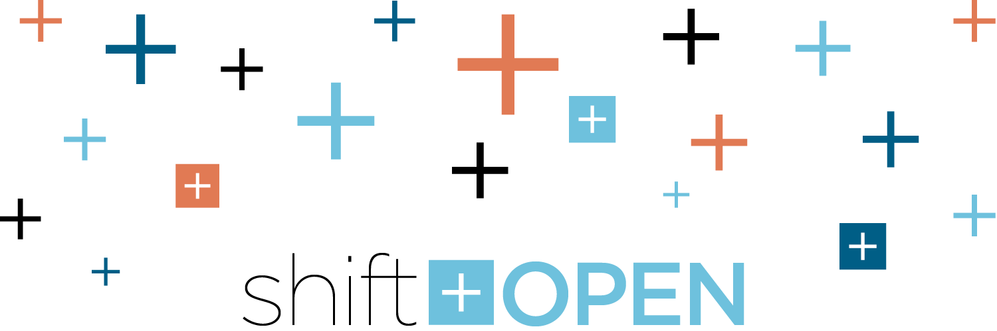
Beyond APC’s , BPC’s , and ADC’s – MIT Press
Journals
the European Sociological Association journals:
‘European Societies’
and
‘European Journal of Cultural and Political Sociology’
will move to diamond open access with MIT Press (away from Taylor & Francis & its subscription model with ‘hybrid’ €2,730 APCs), in 2025.
https://mitpress.mit.edu/european-sociological-association-journals-european-societies-and-european-journal-of-cultural-and-political-sociology-move-to-diamond-open-access-at-the-mit-press/

Slide 21


Beyond APC’s , BPC’s , and ADC’s – MIT Press
Journals
NSF has provided additional funding, a 2-year grant of $275,000 USD to expand the MITP shift+OPEN programme
https://mitpress.mit.edu/national-science-foundation-research-award-will-expand-shiftopeninitiative/

Slide 22


Beyond APC’s , BPC’s , and ADC’s – an example – MIT Press
MIT Press is doing overlay journals too – open peer-review of preprints
https://rrid.mitpress.mit.edu/
RR\ID is published by The MIT Press with generous support from the Gates Foundation, the Patrick J. McGovern Foundation and edited by a team from UC Berkeley.

Slide 23


Beyond APC’s , BPC’s , and ADC’s – using ‘green’ infra to support ‘diamond’
Green diamonds?
Diamond OA publishing services
Repositories

Slide 24



Beyond APC’s , BPC’s , and ADC’s – using ‘green’ infra to support ‘diamond’
Repositories as a strong, common base upon which different communities can grow?
Humanities
Social sciences
STEM

Slide 25


Beyond APC’s , BPC’s , and ADC’s – overlay journals & peer-review communities
The COAR Notify Initiative
The aim of the project is to develop and accelerate community adoption of a (open) standard, interoperable, and decentralised approach to linking research outputs hosted in the distributed network of repositories with resources from external services such as overlay-journals and open peer review services, using linked data notifications.

Slide 26
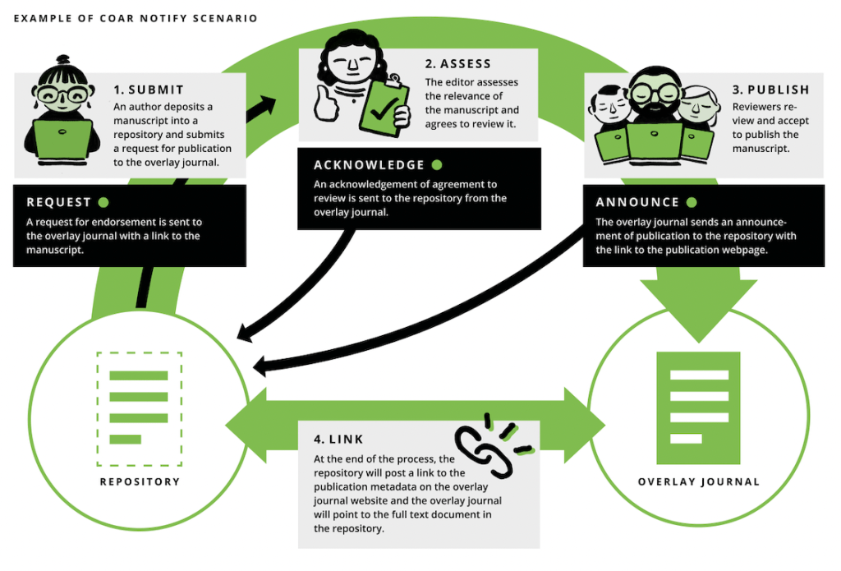
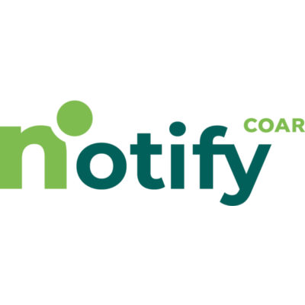
Beyond APC’s , BPC’s , and ADC’s – overlay journals & peer-review communities

Slide 27
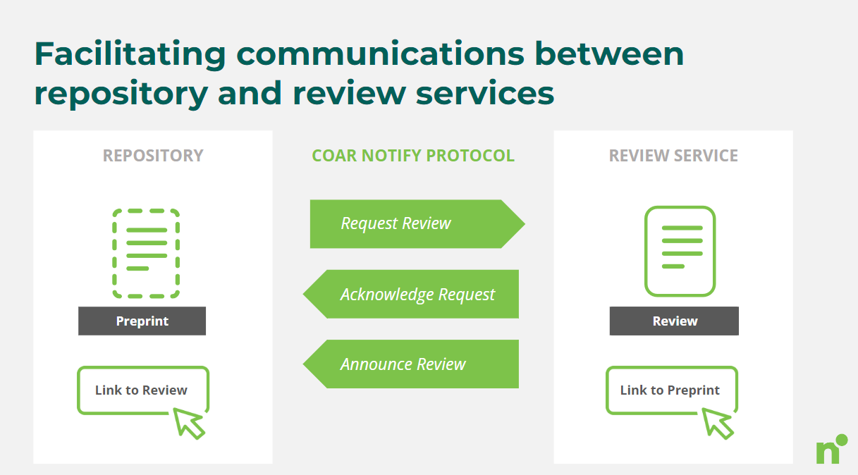
Beyond APC’s , BPC’s , and ADC’s – overlay journals & peer-review communities

Slide 28

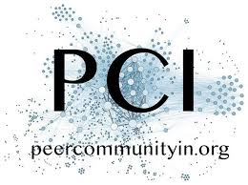
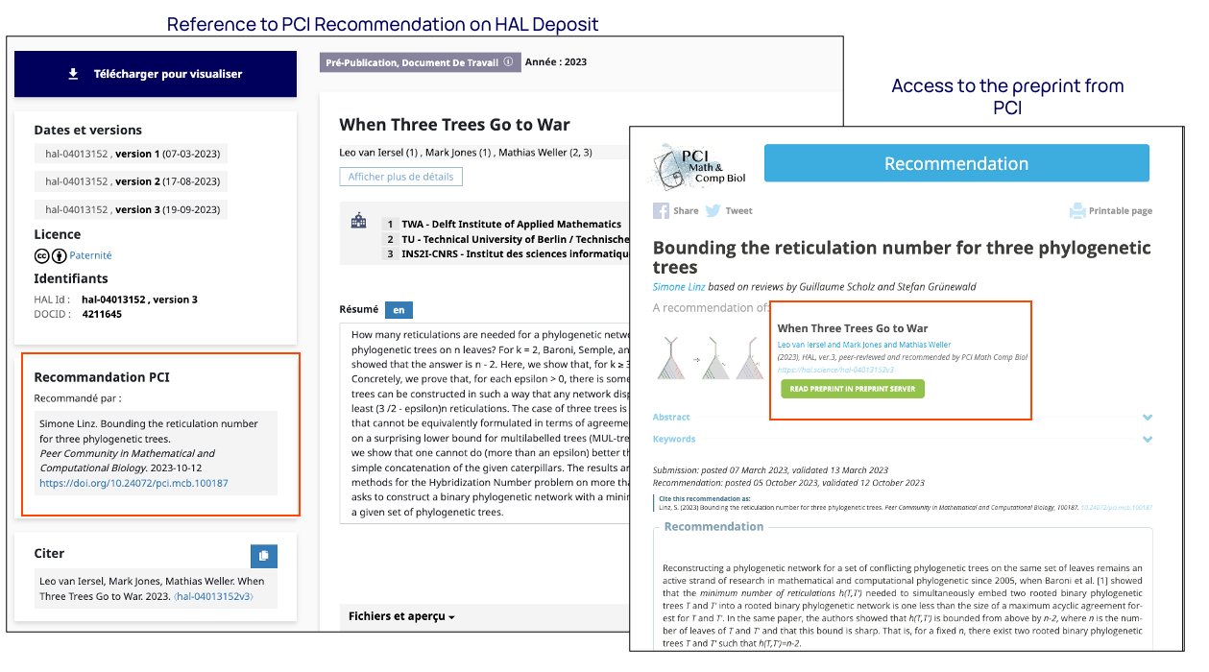
Beyond APC’s , BPC’s , and ADC’s – overlay journals & peer-review communities
Bidirectional signalling
hal.science/hal-04013152v3
10.24072/pci.mcb.100187

Slide 29
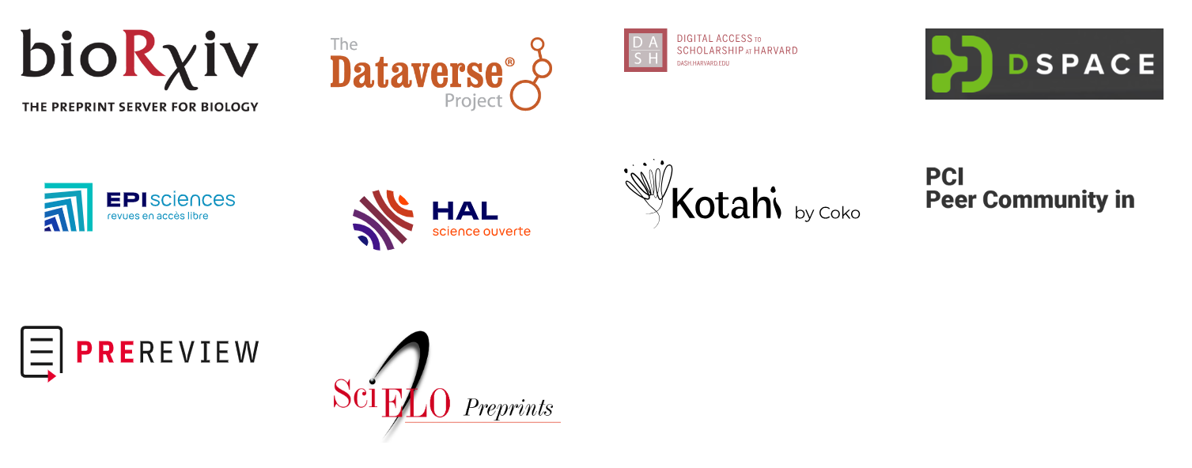


Beyond APC’s , BPC’s , and ADC’s – overlay journals & peer-review communities

Slide 30
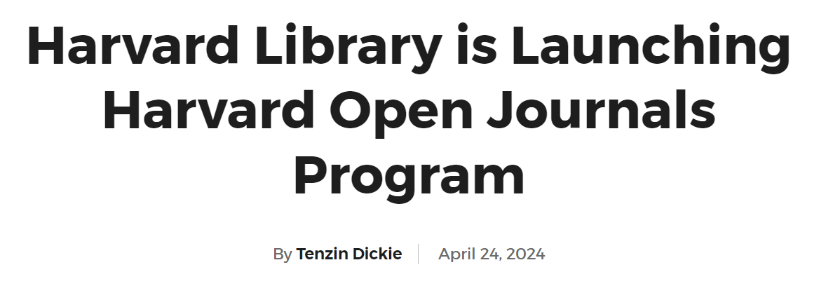

Beyond APC’s , BPC’s , and ADC’s – overlay journals & peer-review communities
https://library.harvard.edu/about/news/2024-04-23/harvard-library-launching-harvard-open-journals-program
The program will offer two support models: an overlay model [using Notify] which takes advantage of open access repositories, such as Harvard’s DASH, and a brand-new academic press model.

Slide 31


Beyond APC’s , BPC’s , and ADC’s – endowment supported publishing
Est. 2005
Has published over 3,832 items
Est. 2010
Has published over 2,400 items
Initially published in co-operation with BioMedCentral (prior to the Springer Nature acquisition), the Beilstein journals are now fully independent.

Slide 32
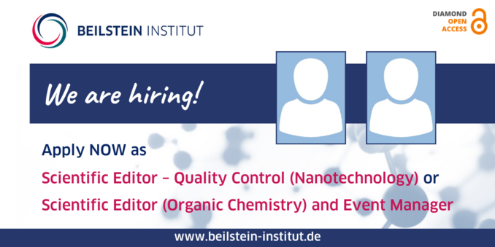
Beyond APC’s , BPC’s , and ADC’s – endowment supported publishing
Mythbusting: Diamond OA should not be conflated with volunteering!
Diamond OA is not about making publishing labour uncompensated
Currently Beilstein are hiring for an additional TWO paid team members, application deadline: June 15th 2024 https://www.beilstein-institut.de/en/about-us/jobs/

Slide 33
Editors & publishing staff need not fear diamond OA
Value-adding publishing labour should be adequately compensated.
Fair pay for fair work.
Under diamond open access models professional publishing labour can and does get paid-for (just not by authors or readers)
On ‘volunteerism’: most peer-reviewed journals ‘invite’ peer-reviewers.
When a peer-reviewer accepts an invite to peer-review that is done voluntarily.
If anyone is to talk of ‘volunteerism’ we must admit that the vast majority* of peer-reviewed academic journals rely on volunteers, in part.
* I am aware of some journals in e.g. economics, that pay peer-reviewers.

Slide 34


Arcadia has helped access to knowledge via endowments: two examples
Endowments as a means of providing financial sustainability
a)
b)
WikimediaEndowment.org
https://mitpress.mit.edu/the-mit-press-receives-10-million-endowment-gift-for-open-access-to-knowledge/ (announced May 2023)

Slide 35
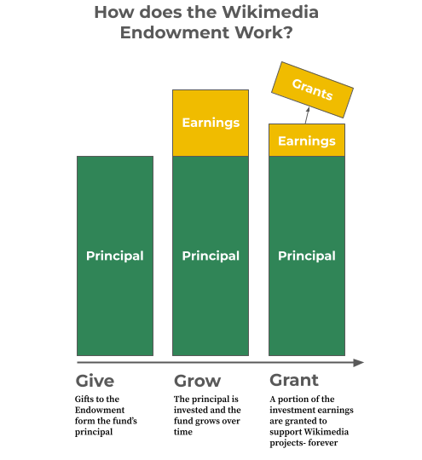
https://wikimediafoundation.org/news/2023/04/13/first-grants-announced-from-the-wikimedia-endowment/

Slide 36

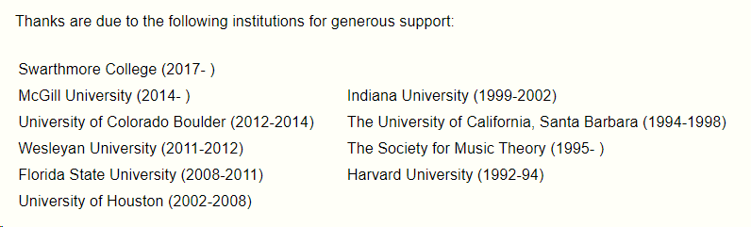
Beyond APC’s , BPC’s , and ADC’s – institutional support
https://www.mtosmt.org/about.html
Music Theory Online has been in continuous publication since 1993, open access, without author-side fees.
It’s also one of the flagship journals of the Society for Music Theory.
Over 31 years of diamond open access publishing

Slide 37
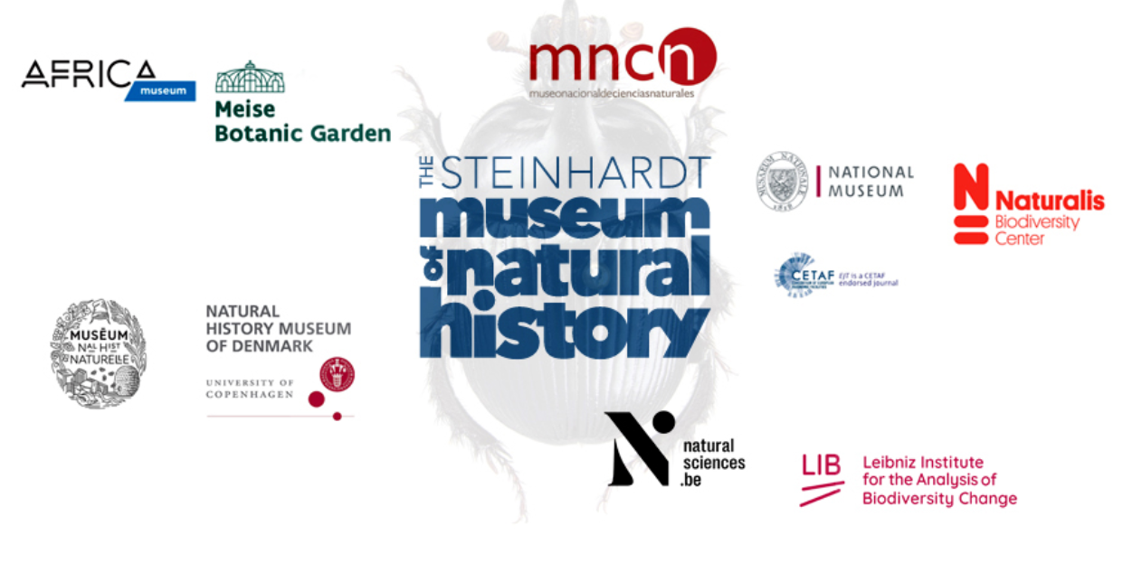
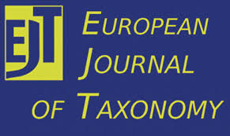

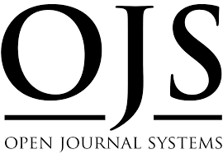
Beyond APC’s , BPC’s , and ADC’s – institutional support
A small consortium of interested stakeholders
The consortium that supports EJT can grow, and is growing (appropriately)
But growth for growth-sake is not necessarily a focus for EJT.
EJT as a model for appropriate, organic scaling c.f. ‘scaling small’.
It started off with just 5 supporting institutions, it now has 10 (growth!)
Recently moved away from using Editorial Manager (Elsevier-owned) to Nestor (EDP)

Slide 38
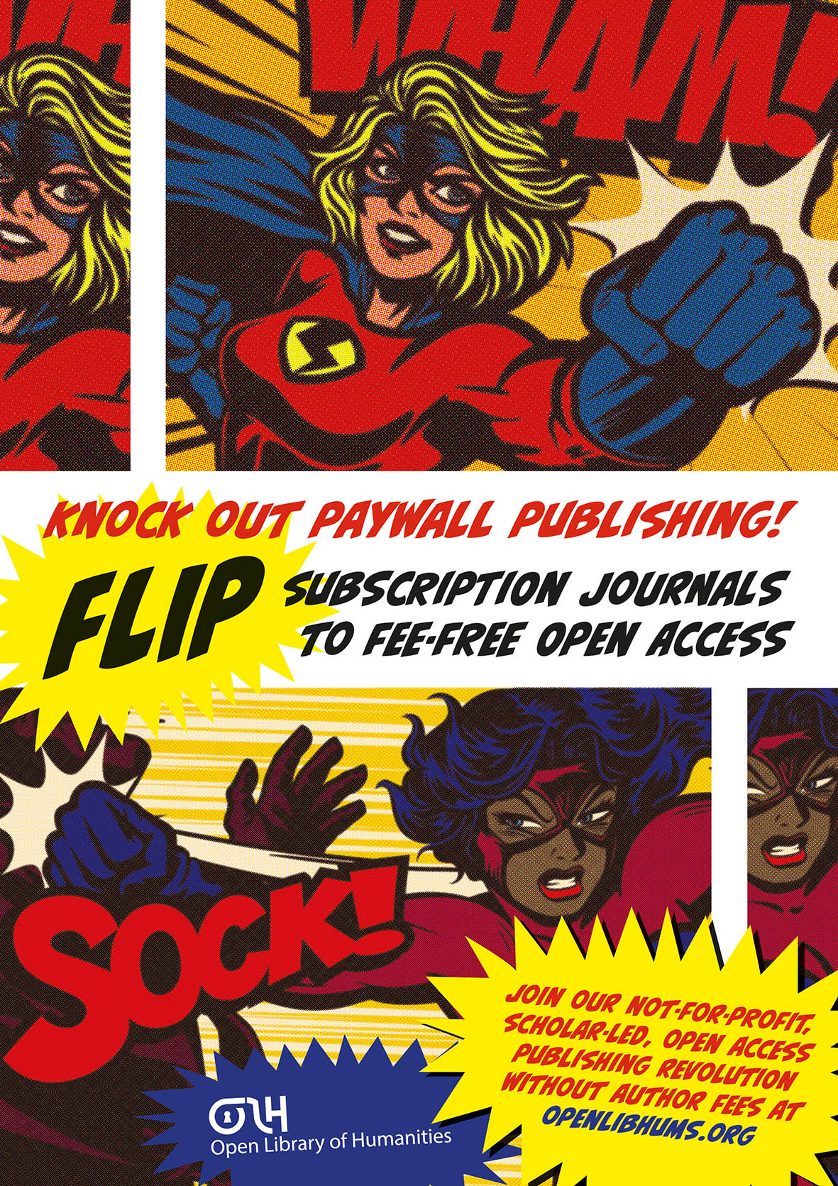


Beyond APC’s , BPC’s , and ADC’s – institutional support
Supported by philanthropic grants from:
Academic-led, great governance
Open Source Software
Diamond OA
Award-winning

Slide 39
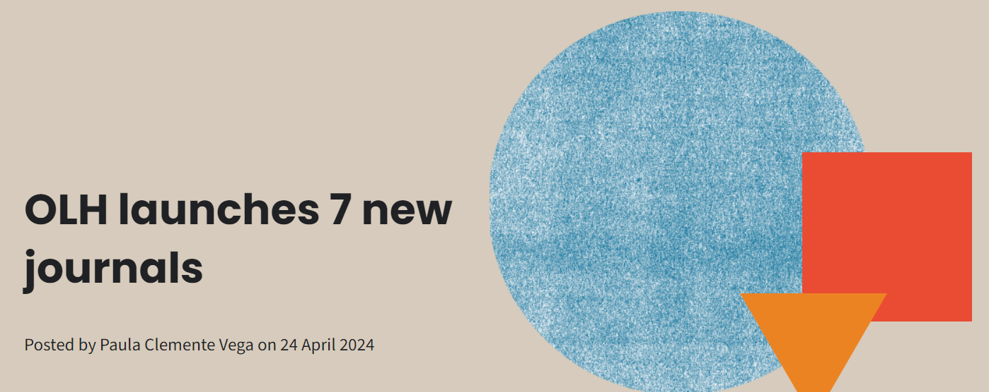
Beyond APC’s , BPC’s , and ADC’s – institutional support
openlibhums.org/news/700/
OLH is also growing. In a sustainable, planned way.

Slide 40
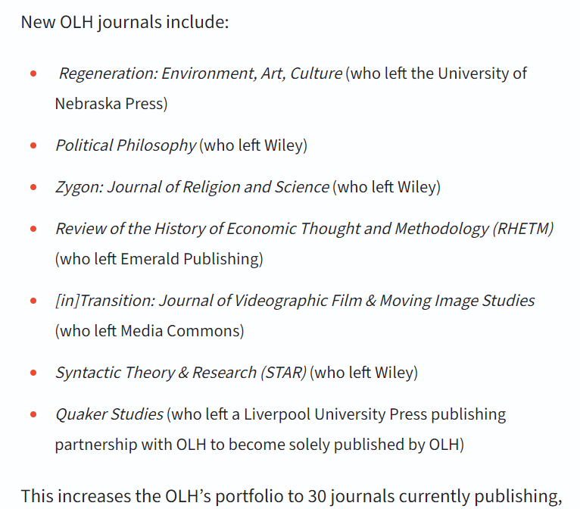
Beyond APC’s , BPC’s , and ADC’s – institutional support
Providing a financially sustainable, well-planned, well-governed home to existing communities seeking to flee the harms of commercial publishing is really smart strategy.
Bravo OLH!
openlibhums.org/news/700/

Slide 41






Beyond APC’s , BPC’s , and ADC’s – institutional support
£2.2 million funding (2019-2022)
An additional £5.8 million funding (2023-2026)
next phase
https://copim.pubpub.org/pub/open-book-futures-announcement/release/1
Grant support:
Making non-BPC models for OA books more mainstream

Slide 42
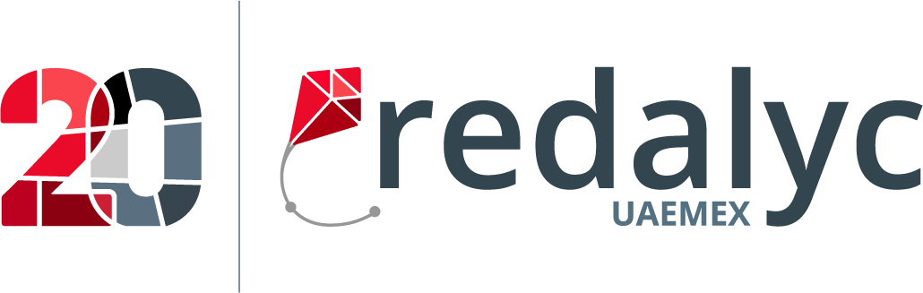

Beyond APC’s , BPC’s , and ADC’s – not just in Europe
Arcadia is proud to support Redalyc and AmeliCA with a 10-year grant of $3.6 million US dollars
(2022-2032)

Slide 43
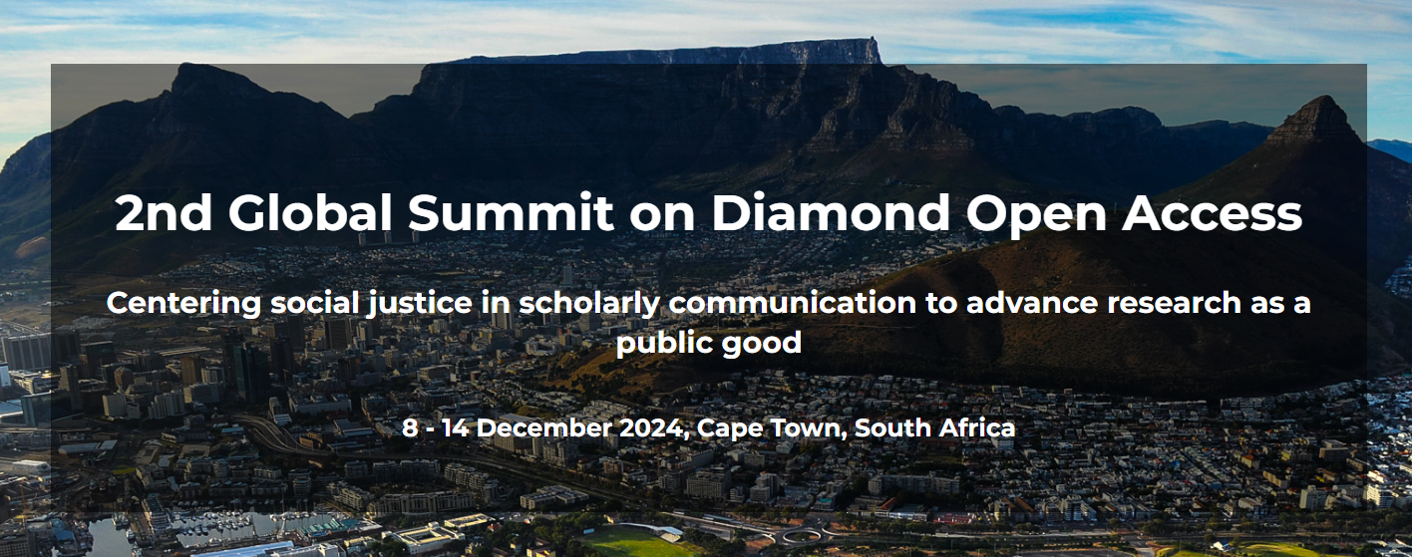
Beyond APC’s , BPC’s , and ADC’s – not just Europe, not just Latin America
doasummit.uct.ac.za

Slide 44

Beyond APC’s , BPC’s , and ADC’s – the Subscribe to Open (S2O) pathway
SubscribeToOpenCommunity.org
Diamond open access is probably easier to achieve for brand new journals & brand new societies.
Diamond OA should always be considered, but if a community considers it ‘too scary’, we must offer next best solutions.
S2O so far is working really well. Particularly appropriate & appealing for humanities & social science disciplines.

Slide 45

Beyond APC’s , BPC’s , and ADC’s – S2O as a gateway to diamond?
Subscription payments
Copyright-transfer to publisher
“all rights reserved”
Paywalled
Highly inequitable
Subscription payments
New content is Open (w/ open licensing)
with no author-side fees, conditionally
Older pre- S2O content stays paywalled
Much more equitable to readers & authors
Recurring support payments (subscription?)
New Content is Open (w/ open licensing), unconditionally

Slide 46

Beyond APC’s , BPC’s , and ADC’s – the Subscribe to Open (S2O) pathway
A non-profit collaboration between libraries and publishers
Popular / known by Anglophone HSS academics, not just OA enthusiasts
Digital humanities and social science content from some 400 university presses and scholarly societies, over 800 journals
Subscribe to Open (S2O) Program for Project MUSE Journals
about.muse.jhu.edu/muse/s2o/
Advertising Educational Foundation
Center for Irish Studies at the University of St. Thomas
Center of Latin American Studies, University of Kansas
The Chinese University of Hong Kong Press
Dictionary Society of North America
Early Theatre
International Vladimir Nabokov Society and Davidson College
Liverpool University Press
Mid-American Studies Association
Philosophy Documentation Center
Scriptorium Press
Sociological Demography Press
The Southwest Center, University of Arizona
UCLA, CMRS Center for Early Global Studies
University of Hawai'i Press
University of Illinois Press
University of Minnesota Press
University of Missouri
University of Nebraska Press
The University of North Carolina Press
University of Pennsylvania Press
University of Texas Press
The University of Tulsa
University of Wisconsin Press
Johns Hopkins University Press
The Ohio State University Press
Purdue University Press

Slide 47



Beyond APC’s , BPC’s , and ADC’s – the Subscribe to Open (S2O) pathway - maths
Open Mathematics Through Subscribe To Open
A discipline-focused cross-publisher initiative to open-up a significant chunk of the discipline.
https://ems.press/open-mathematics-through-subscribe-to-open

Slide 48
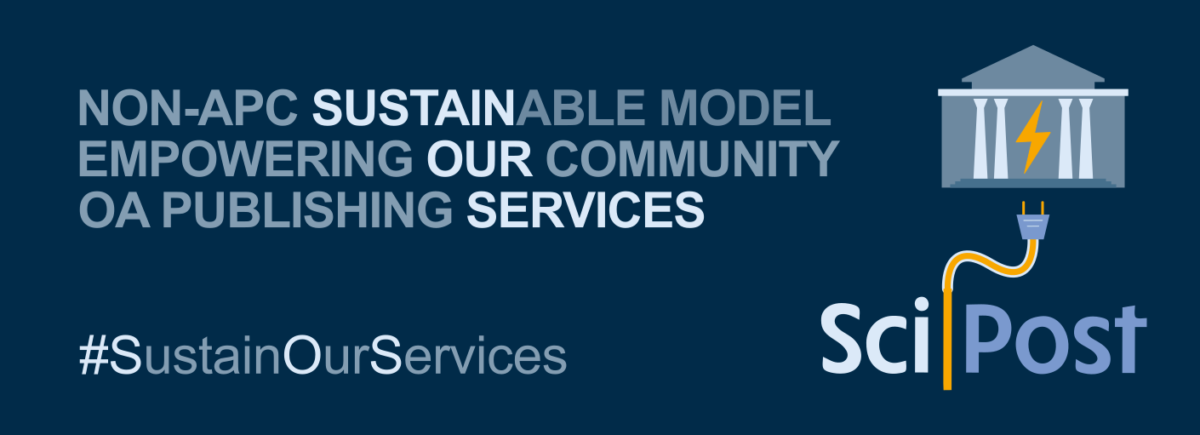
Beyond APC’s , BPC’s , and ADC’s – the Subscribe to Open (S2O) pathway
Am I entirely uncritical of S2O? No.
I think S2O as practiced so far is too silent on financial transparency & governance.
Who decides what the ‘target’ financial amount is each year?
Do we trust the publisher to faithfully report the income it has received from each library towards the ‘target’ amount that triggers open?
What does it actually cost each publisher to publish?
Which gets me back to the POSI principles I mentioned earlier.
Those operating in diamond OA can offer superb financial transparency e.g. SciPost.
We should reward good governance and financial transparency.

Slide 49

Recognising Diamond Open Access outputs in research assessment
Any organisation only using Scopus/SciVal (Elsevier) , Web of Science / InCites (Clarivate), or both is actively harming progress towards an equitable open access system.

Slide 50
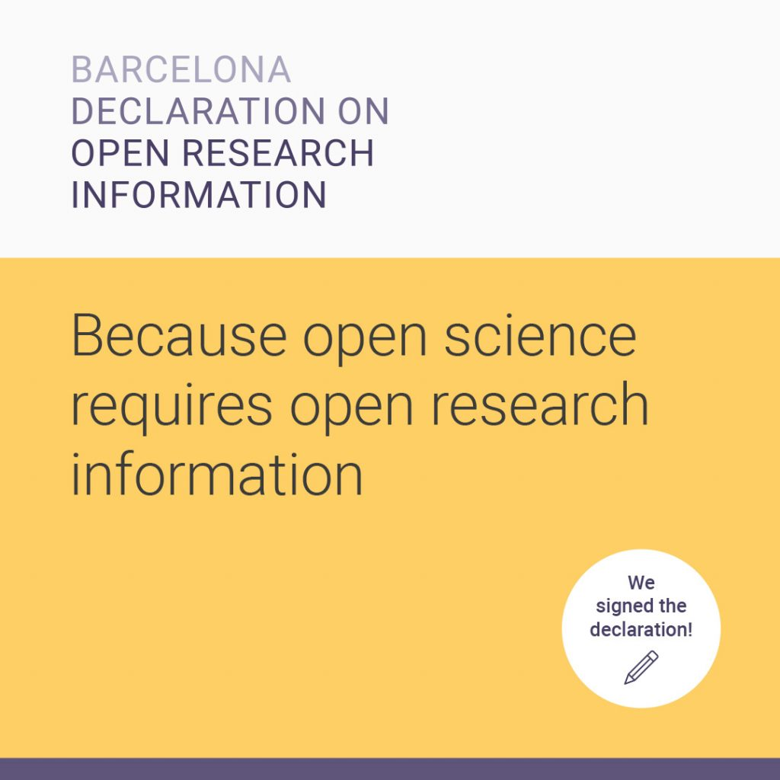
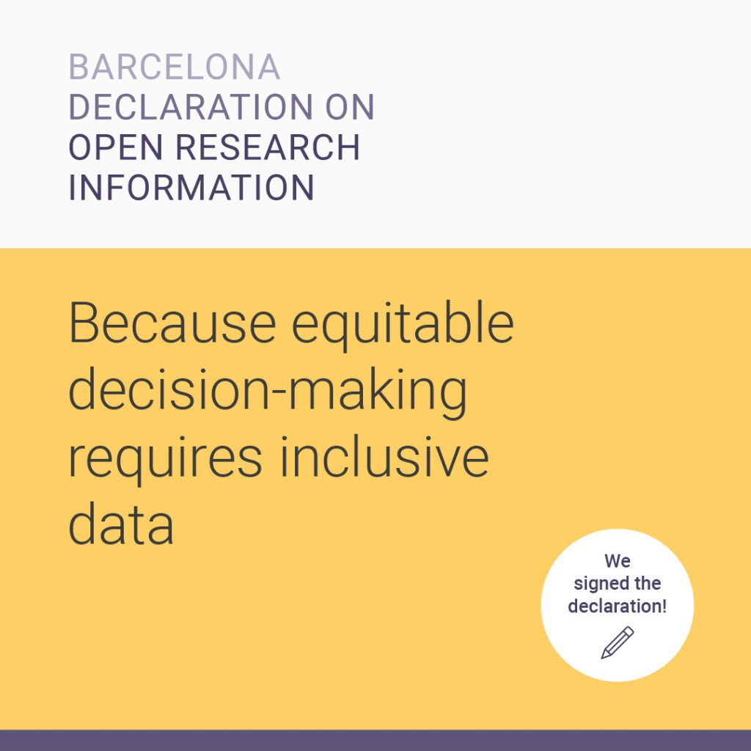
Barcelona Declaration on Open Research Information
Launched April 2024
barcelona-declaration.org

Slide 51

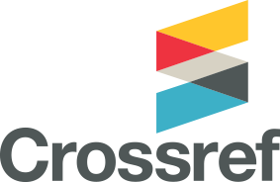

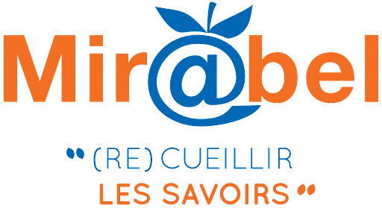



Open Research Information service providers – local, regional & global

Slide 52
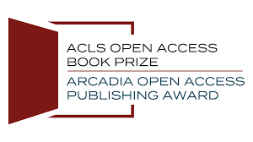

Rewarding longform open access publication in HSS disciplines
Prize winners announced NEXT WEEK (2nd May 2024)
Authors receive the ACLS Open Access Book Prize, with a cash award of $20,000.
Publishers receive the Arcadia Open Access Publishing Award, with a grant of $30,000 to support new open access titles.
https://www.acls.org/programs/open-access-book-prize/

Slide 53
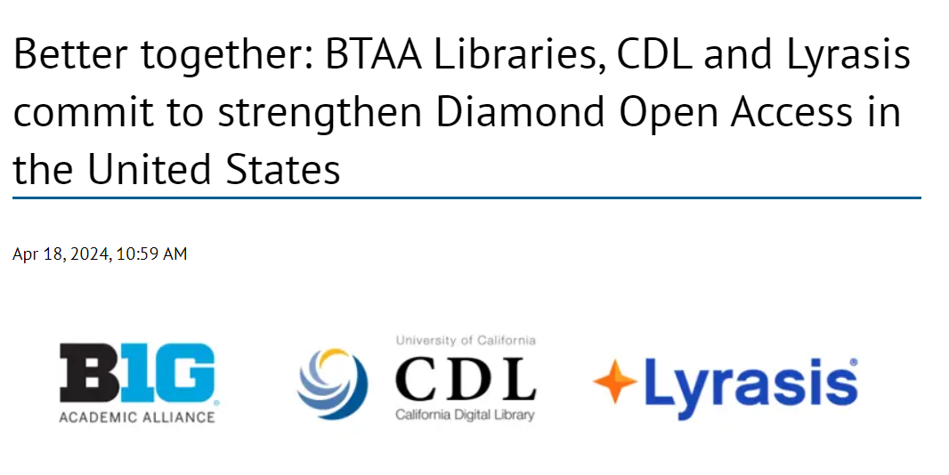
Diamond OA funding support from the USA. It’s coming.
https://btaa.org/about/news-and-publications/news/2024/04/18/better-together--btaa-libraries--cdl-and-lyrasis-commit-to-strengthen-diamond-open-access-in-the-united-states

Slide 54
Let’s not forget how bad the traditional journal system is…
A reminder of just how mis-aligned the legacy publishing system is [in 2024]

Slide 55
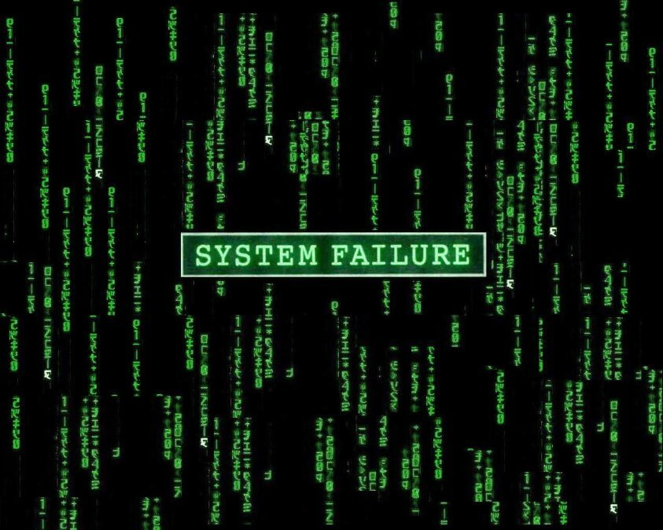
Let’s not forget how bad the traditional journal system is…

Slide 56
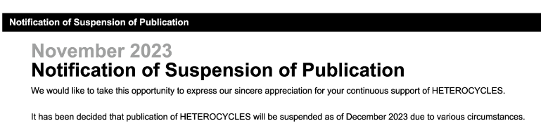

What happens when commercial interests override everyone else’s interests?
Let me tell you about a journal called ‘Heterocycles’ (ISSN: 0385-5414)…
A paywalled, subscription access journal. A ‘key’ one in chemistry (according to Chemistry World)
Indexed in both Web of Science and Scopus (markers of quality? Or not as it turns out…!)
It has published over 17,000 articles.
Screencrop of official journal website as of 2024-04-25

Slide 57
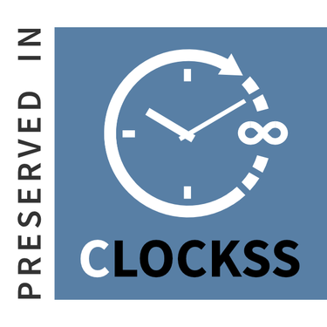
Read the fine print of CLOCKSS agreements…
The journal has been globally unavailable online for roughly 5 months now.
CLOCKSS, somewhat remarkably hasn’t asserted that this qualifies as a ‘trigger event’ yet.
(I infer) the publisher might be claiming that they are still in business negotiations to sell-on the journal
CLOCKSS Participating Publisher Agreement says that Trigger Events can only happen through (i) unconditional agreement of publisher or (ii) content is unavailable for six months.

Slide 58
The authors, the subscribing libraries, the research institutions, the funders?
I repeat. 17,000+ ‘key’ chemistry articles are currently offline.
Some of these were published in 2023 e.g.
“Synthesis of Arylideneisoxazol-5-ones Catalyzed by Sodium Cyclamate” authored by Ziba Daroughezadeh and Hamzeh Kiyani and published in Heterocycles in 2023, pp. 1187-1197, with the DOI: 10.3987/com-23-14859
Imagine if an article YOU authored in 2023, was vanished like this
Imagine if an article your research funding organisation funded in 2023 vanished like this
Imagine if an article your research performing organisation produced in 2023 vanished like this
Imagine if your library pays to subscribe to this journal (!!!)

Slide 59
The harmful consequences of letting scholarship be a private good
17,000+ research articles have been made globally unavailable online, rather needlessly.
This is directly attributable to the way non-OA scholarship is allowed to be tradeable “intellectual property”, exploited and imprisoned for private gain.
This situation would not be possible under a system with open licensing – where everyone has the right to repost and rehost content, even if they are a third-party.
We desperately need to start treating research as a public good, and to protect it from the harm of narrow private interests.

Slide 60
Acknowledgements
This talk draws upon discussions with many people including, in no particular order: Joe McArthur (OA.Works), Jason Priem (Our Research), Cameron Neylon (Curtin University), Chris Banks (Imperial College London), Ashley Farley (Gates Foundation), Heather Joseph (SPARC), Arianna Becerril-García (UAEM / Redalyc / AmeliCA), Kathleen Shearer (COAR), and many more…
Many thanks also to the conference organisers.
Zadar is a very beautiful place and I am glad to be here once again.
Any Questions?

